Slide 1
Macroeconomics II
Lecture 17
Industrial policy: arguments and critique
Notes:
1

Slide 2
Theoretical Lecture 17 Industrial policy arguments and critique (2)
Topics:
Arguments for industrial policy
Limits of market conforming growth path,
Dynamic industrial policy
Examples of industrial policy
Critique of industrial policy
Conclusions
Readings:
Chang, Ha-Joon (editor). 2006. Rethinking development economics. Anthem Press: London. (Chapter 2, pp. 41-60; Chapter 12, pp. 257-276; Chapter 22, pp. 499-522).
Chang, Ha-Joon. 2004. Globalization, economic development and the role of the State. Zed Books: London (Chapter 4, pp. 105-55)
Chang, Ha-Joon. 1996. The political economy of industrial policy. MacMillan Press: London
Fine, Ben. 1997. Industrial Policy and South Africa: a strategic view. NIEP Occasional Paper Series, no 5, April, Johannesburg, National Institute for Economic Policy.
Fine, Ben and Zavareth Rustomjee. 1996. The political economy of South Africa: from minerals-energy complex to industrialization. Westview Press: London [Chapters 2 (pp 19-62), 3 (pp 63-70), and 9 (pp 208-240)]
2
Notes:
2

Slide 3
Dynamic industrial policy
“It is harder for an industry to push the technological frontier forward, or even keep up with it, if its own rate of expansion slows down – and still harder if it is contracting. This is unavoidable but tolerable when the growth of old industries is restricted by the rise of newer, more progressive home industries. But when retardation of older home industries is due to the rise of competing industries abroad, a tendency to generalised slowdown may be present.” (Ocampo & Taylor)

Slide 4
Dynamic industrial policy
What is dynamic/selective industrial policy?
“We propose to define industrial policy as a policy aimed at particular industries (and firms as their components) to achieve outcomes that are perceived by the State to be efficient for the economy as a whole.” (Chang, 2004, pp. 112).
Industrial policy is not the same as trade barriers, although trade barriers may, or may not, be utilised as instruments in specific industrial policies under specific conditions.
Trade barriers are not limited to import/export duties, quotas and other foreign trade barriers – there are many, including barriers to entry, patents, price collusions, and so on, all of which can be thought of as trade barriers in neoclassical terms, or as dynamic industrial policies in structuralist terms.

Slide 5
Dynamic industrial policy
Industrial policy is not the same as trade barriers, although trade barriers may, or may not, be utilised as instruments in specific industrial policies under specific conditions.
Trade barriers are not limited to import/export duties, quotas and other foreign trade barriers – there are many, including barriers to entry, patents, price collusions, and so on, all of which can be thought of as trade barriers in neoclassical terms, or as dynamic industrial policies in structuralist terms.
The most generalized and globally organized system of trade policies and barriers in history was colonialism, which was a central component of the process that created global inequalities, which are taken advantage of by industrial and financial capitalism.

Slide 6
Arguments for industrial policy
Market conforming
(what the market would do if it was perfect)
Dynamic industrial policy
(infant industry)
Historical & Social location of economic policy
Non-marginal change – need state
Rejects state vs market debate
Follows factor endowed comparative advantages – need markets
Static coordination (lower transaction costs)
& Dynamic coordination (learning)
Political “will” & “power” differ
Provision of fundamentals (macroeconomic stability, infrastructures and human capital).
Industry and policy located in specific economies and political settings
Correction of market failure & reduction of transaction costs (information, property rights, contracts)
Selective (firms, technologies, markets) industrial policy
Social structures of accumulation determine economic patterns & focus, scope, specificity and effectiveness of policies
Institutions are built as needed and by learning
Concerned with state failure (capabilities, rent-seeking and predatory behaviour)

Slide 7
Limits of the market conforming growth path
Market conforming convergence model does not occur (no market conforming structural change):
initial factor price differences may be too large for equalisation to occur;
factor rigidity (ex, labour market rigidities, capital rigidities associated with financial systems, skills and infrastructures, etc.)
wrong factor intensity analysis: change in factor endowments, factor intensity reversal, capital controversy (capital intensity, and so labour intensity, cannot be measured), distribution between surplus and labour is social, rather than natural;
shifts in production/technological capabilities and patterns may be non-marginal, they have cumulative and dynamic effects in economic trajectories

Slide 8
Dynamic industrial policy – Static dimension of coordination
Nature of the coordination problem:
Increasing returns to scale (IRS) make the actions of individual agents non-negligible and interdependence, hence coordination, becomes important
No firms can anticipate all the actions and outcomes of competition
Lack of coordination is wasteful because of assets specificity in industrial economies – if assets of bankrupt firms become unproductive there is an overall fall in productive capacity, employment and income.
Price wars and strategic uncertainty may arise, leading to over- or under-investment and crises

Slide 9
Dynamic industrial policy – Static dimension of coordination
Industrial policy as a static coordination device:
Optimal (involving restriction) to entry in industries with IRS to avoid wasteful price wars and guarantee efficient scale of production
Recession cartels (such as oligopolistic output negotiations) to deal with temporary, unforeseen fluctuations in demand
Negotiated exit/capacity scrapping, including compensation and retraining of workers, when changes in demand are permanent or long term

Slide 10
Dynamic dimension of industrial policy – nature of economic change

Slide 11
Dynamic dimension of industrial policy – nature of economic change
Industrial policy as a dynamic coordination device:
Coordination of interdependence of interlocked assets and capabilities: indicative planning with focal points (including public investment) for complementarities; financial incentives for cooperative research into new areas and industries
Codifiability of knowledge and the product cycle – incorporating knowledge generation and sharing in industrial policy (encouraging experimentation and learning by infant industries)
Diversity of sources of innovation: subsidisation of potential new entrants that are equally capable as the incumbent, except financially; subsidisation of and cooperative R&D; promotion of basic research at Universities.

Slide 12
Industrial policies & the product/business cycle

Slide 13
Evidence – utilization of trade tariffs protection (import duties)

Slide 14
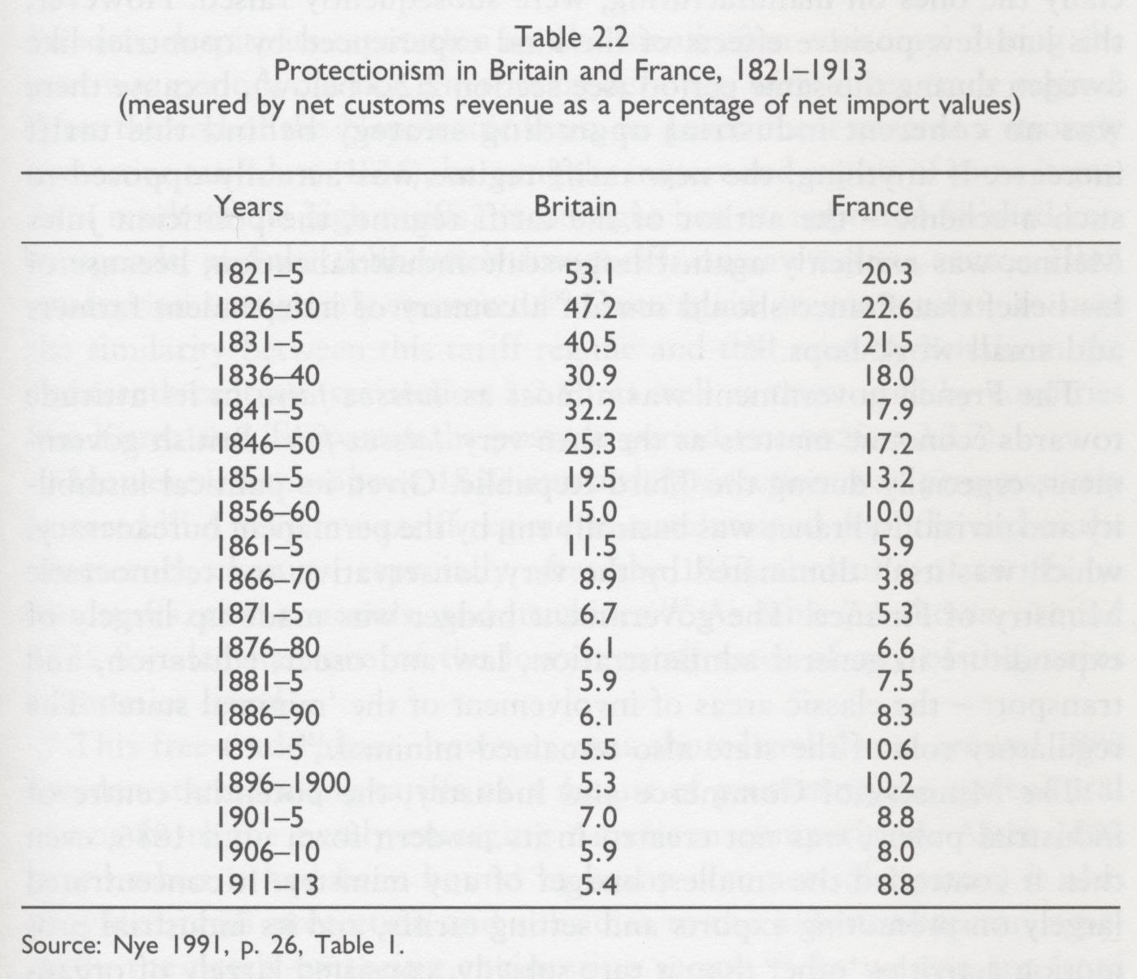
Evidence – utilization of trade tariffs protection (import duties)

Slide 15
And tariffs discriminate
2002: India's exports paid more tariffs, in absolute value, in the USA than the UK (3 times larger and which exported much more)
Bangladesh paid as much as France as tariffs to the UK, in total value (despite the fact that its economy was 3% of that of France)
Import tariffs on final, manufactured products may be significantly higher than on raw materials, thus making it more difficult for exporters of raw materials to move into exports of manufactures outside of the narrow scope given by standardized, cheap labour simple manufacturing

Slide 16
Boeing (USA) vs Airbus (Europe)
Large corporations competing for the same market, in oligopolistic markets of limited size.
Costs of “price war” prohibitive for companies and governments (which subsidised them) in the long run, affecting their ability to invest and innovate (as resources were spent seeking subsidies, subsidizing and lowering prices).
Strategic trade options:
Eliminate one of them, or
Specialize them in different market niches (this is, divide/share the market between oligopolies according to specificities in market demand and characteristics of production – product and market differentiation)
Second option (market sharing) was adopted in what Paul Krugman called strategic, oligopolistic trade theory/policy

Slide 17
EU vs China (trade and industrial policy)
China joined the WTO in December 2001
Trade with the EU grew very fast, initially with exports of China being light industries – greatly affecting exports of EU peripherical economies to the EU, as they exported the same as China, but not as competitively.
Since EU countries that are members of the Euro mechanism have no independent monetary policy, they could not devalue the currency, and devalued wages instead.
Trade deficit of EU vs China increased sharply, but affected mostly peripherical economies, which to compete against China for the EU market, not so much German and France, which were exporting technology intensive products

Slide 18
EU vs China (trade and industrial policy)
China utilised huge economic surplus to finance technological development: science and technology effort at home and purchase of technology based/focuses firms in the world
The structure of exports of China to EU started to change towards technology intensive products (52% of China’s exports to the EU in 2019), competing with Germany and France.

Slide 19
EU vs China (trade and industrial policy)
France and Germany, who had opposed selective industrial policies to protect peripherical EU economies, begun to work on industrial policy to counteract China: new investment and trade codes; new trade tariff barriers associated with human/workers rights, environment, phytosanitary regulations, transparency; limitations to foreign (outside of EU) purchase of technologically intensive firms and capabilities in the EU, public investment in research & development (R&D) in high tech areas, such as 5G infrastructure and technology, artificial intelligence (AI), and so on.
Is a political window opening for a serious debate and reconsideration of the role of industrial and trade policy in the EU, more broadly? To what extent this can be done given the dynamics of financialization of the European capitalist economies, the existing rules and regulations in the EU and WTO, and the fragility of public finances following the financial crisis of 2008 and the pandemic caused by SARS-CoV-2?

Slide 20
Patents and industrial policy
What are patents?
Why?
Problems
Case for knowledge as public goods
Registered property right over technology, technique, process, product, knowledge, research
Property rights: creation & protection of rent
Unequal power: large organizations and economies in knowledge production and appropriation
Full access
Indigenous knowledge and interrelated knowledge
Commoditization of knowledge & technological capabilities
Encourage production of knowledge
Divergence in world growth pattern trajectories
Encourage disclosure and sharing
Technology that interferes with evolutionary process of species & AI
Controversy over: whether they are indeed needed; private appropriation of public investment in R&D; monopoly prices (ex, medical drugs)
Market rigidity/rent introduced by putting a high price on a transaction, in order to, ironically, guarantee market efficiency
A substitute for industrial policies (ex, subsidization of innovation of infant industries)
Moral/ethics humanism before profits
If technology is not equally and instantaneously available to all, market efficiency models break down

Slide 21
The fight for patents
Swiss authorities refused to grant patents on chemicals (against German industry) – it remained so until 1978
Netherlands abolished the patent system in 1869, to be forced to reestablish it only by 1912 (this is how Philips was developed, “borrowing” Edison's patent on light bulbs)

Slide 22
Top PCT firm applications in Europe (2017)

Slide 23
Justin Lin vs Ha-Joon Chang
The peer reviewed journal Development Policy Review 2009, 27(5), published a debate between Justin Lin (then senior economist and vice-president of the World Bank), and Ha-Joon Chang (Professor of political economy of development, University of Cambridge), titled Should Industrial Policy in Developing Countries Conform to Comparative Advantage or Defy it? A Debate Between Justin Lin and Ha-Joon Chang

Slide 24
Justin Lin vs Ha-Joon Chang
The two economists share similar frameworks of analysis but disagree about a variety of issues, namely:
the degree of market conformity with or departure from endowed comparative advantages in industrial policy. Hence, they disagree about the relevance given to states or markets in the development process.
Justin Lin models comparative advantages with the HOS trade theory (comparative advantages given purely by endowed relative factor intensity), whereas Ha-Joon Chand models his comparative advantages on Ricardo’s, which takes into consideration how conditions of production (including technologies) may result in different economic trajectories associated with different directions of specialization and linkages potential.

Slide 25
Justin Lin vs Ha-Joon Chang
the interpretation of observations from history, namely about conformity and departure from comparative advantages, state and market failure,
and the relevance of neoclassical models that inform economic policy without consideration for specifics of technological dynamics, costs of adjustment and differences between sectors, firms, technologies and markets.

Slide 26
Critique of industrial policy
Neoclassical critique
State capabilities: incomplete information and information asymmetries
Political economy: rent-seeking and predatory state
Legitimacy and democratic control
Institutions required (institutions are not factor endowments)

Slide 27
Critique of industrial policy
Broader, heterodox critique:
State vs market debate is an inadequate description of how the economy functions; states and markets are influenced by the same forces (linkages/economic pressures and agents), whose interaction forms the structures of accumulation, and states operate through markets
Political “will” and “power”, as well as feasibility of policies – drawn from political economic conditions
How industrial policy is defined, quite apart from how it is formulated, implemented and monitored, reflects competing economic and political pressures and interests that choose to highlight some aspects of policy at the expense of others

Slide 28
Critique of industrial policy
All policies of significance have impact on industrial performance.
Macroeconomic policies: demand, interest rates and exchange rates, all of which have a direct impact on industrial performance through market access, costs of capital and intermediate goods and export competitiveness at the margin.
Labour market policies: industrial relations, wage rates and the skills of the working force, also have a direct impact on industrial performance.
Global view of industrial policy calls attention of analysis and policy to:
industrial policy is situated within the context of the economy as a whole and responds to a strategy of capital accumulation of one type or another;
many factors concur to influence which specific policies are adopted and/or chosen to be mentioned, and why the impact of similar policies may differ substantially over time and across countries and industries;
industrial policy takes place within the framework given by the specific economic and political structures and dynamics of capital accumulation, their internal tensions and struggles.

Slide 29
Conclusions
Growth trajectories, speed, sustainability and transformative power are related to socioeconomic transformation, which, in the literature, is associated with industrialization
The power of industrialization arises from (a) evidence that links “virtuous” cycles to industrialization; (b) dynamic and cumulative increasing returns; (c) the social and historical nature of capital accumulation and capitalist transformation of society.
Neoclassical economics understands industrialization as a market conforming process based on endowed comparative advantages. H-O models predict long term convergence and equalization of relative factor intensity and prices

Slide 30
Conclusions
Structuralist economics argues for dynamic industrial policy on the grounds of required non-marginal change;
New-institutionalists argue for industrial policy on the grounds of static (coordination of investment and response to crises) and dynamic (coordination of interdependence, learning and innovation) coordination, because of coordination failure.
Neoclassical critique of industrial policy/strategy focus on state capacity, rent-seeking, predatory states, legitimacy and democratic control and the “cost” and difficulty to building required institutions.

Slide 31
Conclusions
Broader and heterodox critique emphasises that all significant policies have impact on industrial performance, that industrial policy is located within a specific economy as a whole, responds to economic linkages and pressures and conflicting interests of agents, the relative success or failure of IP depends on many different socially and historically related factors, and that the industrial policy and industrial and growth patterns emerge from specific structures of capital accumulation, social tensions and struggles associated with it and how they are resolved.

